Slide 1
Aerosol and Cloud modelling over the Southern Ocean in ACCESS-AM2
Sonya Fiddes (AAPP, UTAS)
Matt Woodhouse (CSIRO), Marc Mallet (AAPP, UTAS), Joel Alroe (QUT), Simon Alexander (AAD), Alain Protat (BoM)

Slide 2
Our goal:
Reduce the SO radiative bias
But this is no small task…

Slide 3

(Eventually) Working on two fronts: global and regional platforms with a complimentary set-up
Develop at a regional scale
Evaluate & test against in-situ obs
Apply to global scale
Evaluate & test against satellite
Contribute to next phase of ACCESS?
Global scale model: ACCESS-AM2 ✅
Regional scale model: UM regional model

Slide 4
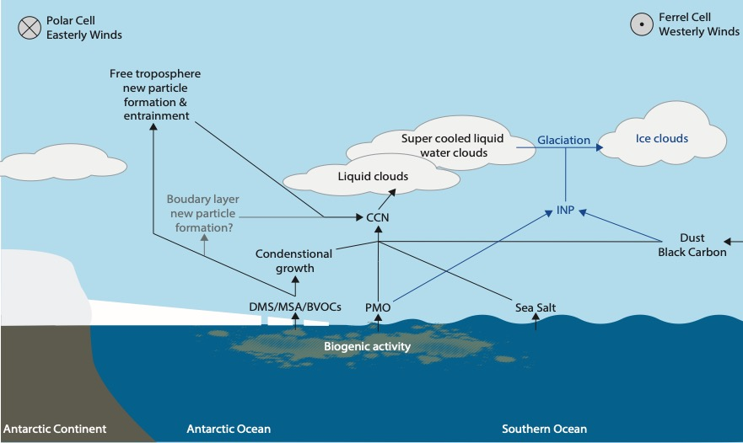
Our (long term) targets:
Natural aerosol emissions that contribute to CCN and INP
Inclusion of methane sulfonic acid into offline chemistry and aerosol
Cloud microphysics: cloud phase link to INP sources
CASIM double moment microphysics (talk to me after)

Slide 5
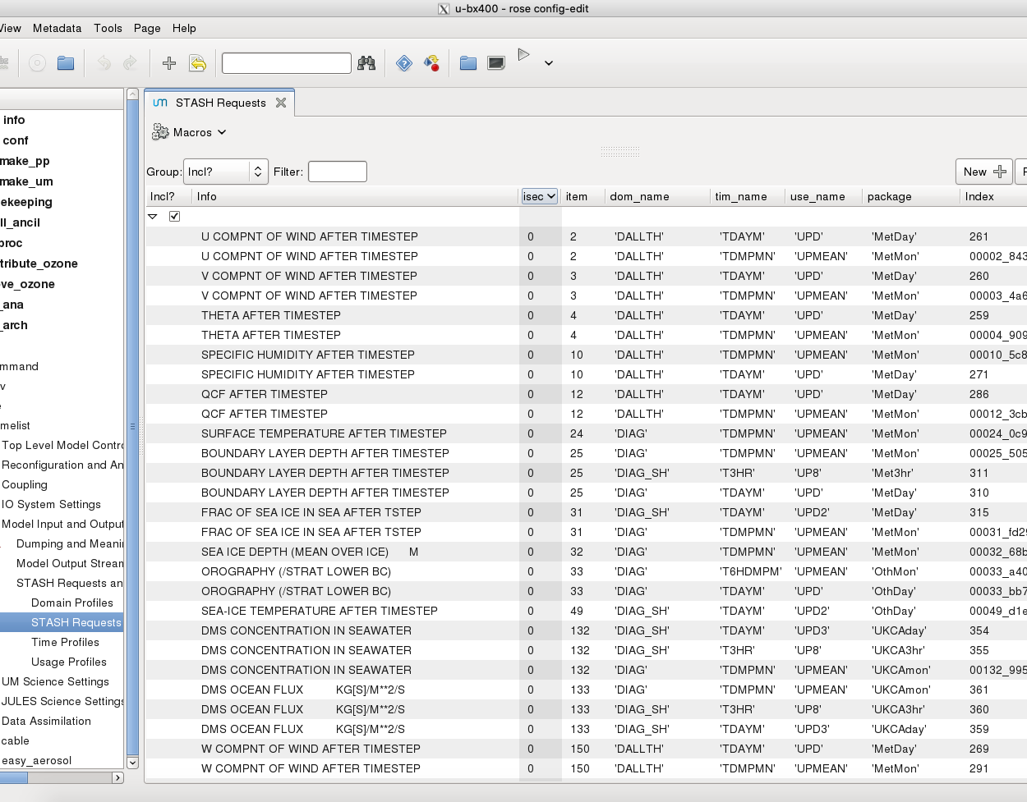
The ACCESS-AM2 control
2015-2018
Daily means (as well as monthly means and limited 3hr instant)
Southern Hemisphere only (limited global fields)
Prescribed AMIP SST/SIC (updated to end of 2019 currently, 2020 to be done when full year available)
Nudged to ERA5 (6hrly: u, v, 𝞱)
COSP output for MODIS and CALIPSO
Aerosol & limited chemistry (inc. budget terms)
The usual met fields

Slide 6
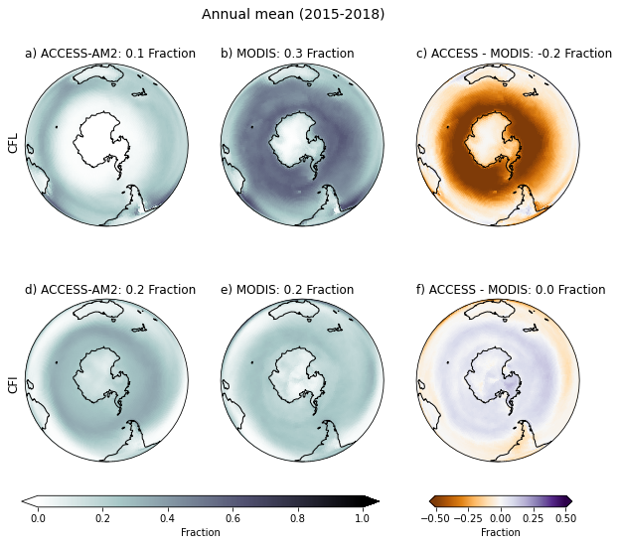
First steps: evaluate!
At the global scale, using COSP output

Slide 7
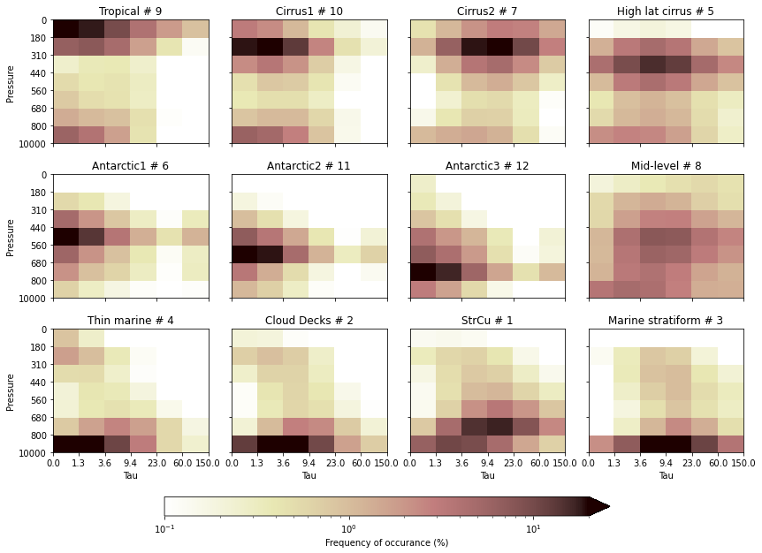
MODIS cloud regime clusters, derived using K-means (shown), then fitted to ACCESS COSP output

Slide 8
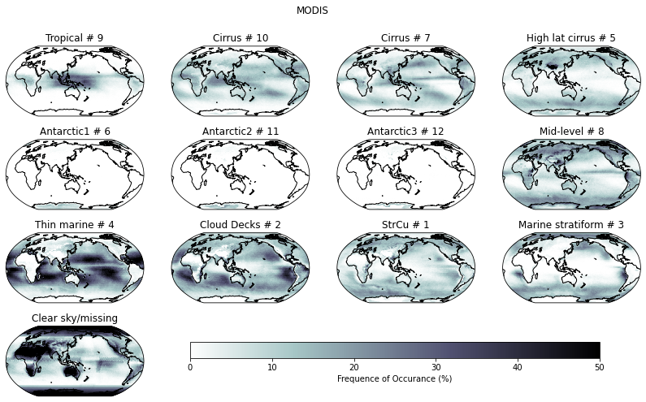
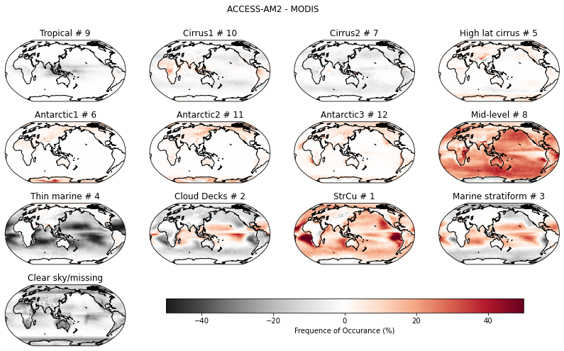
ACCESS is significantly biased towards one type of cloud…. mid level with medium range optical thickness

Slide 9
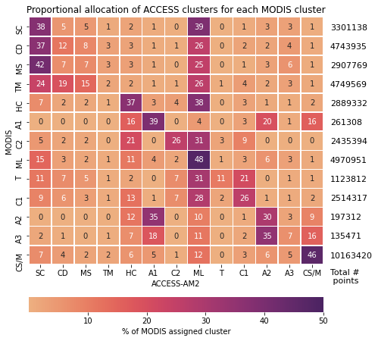
ACCESS is significantly biased towards one type of cloud…. mid level with medium range optical thickness

Slide 10
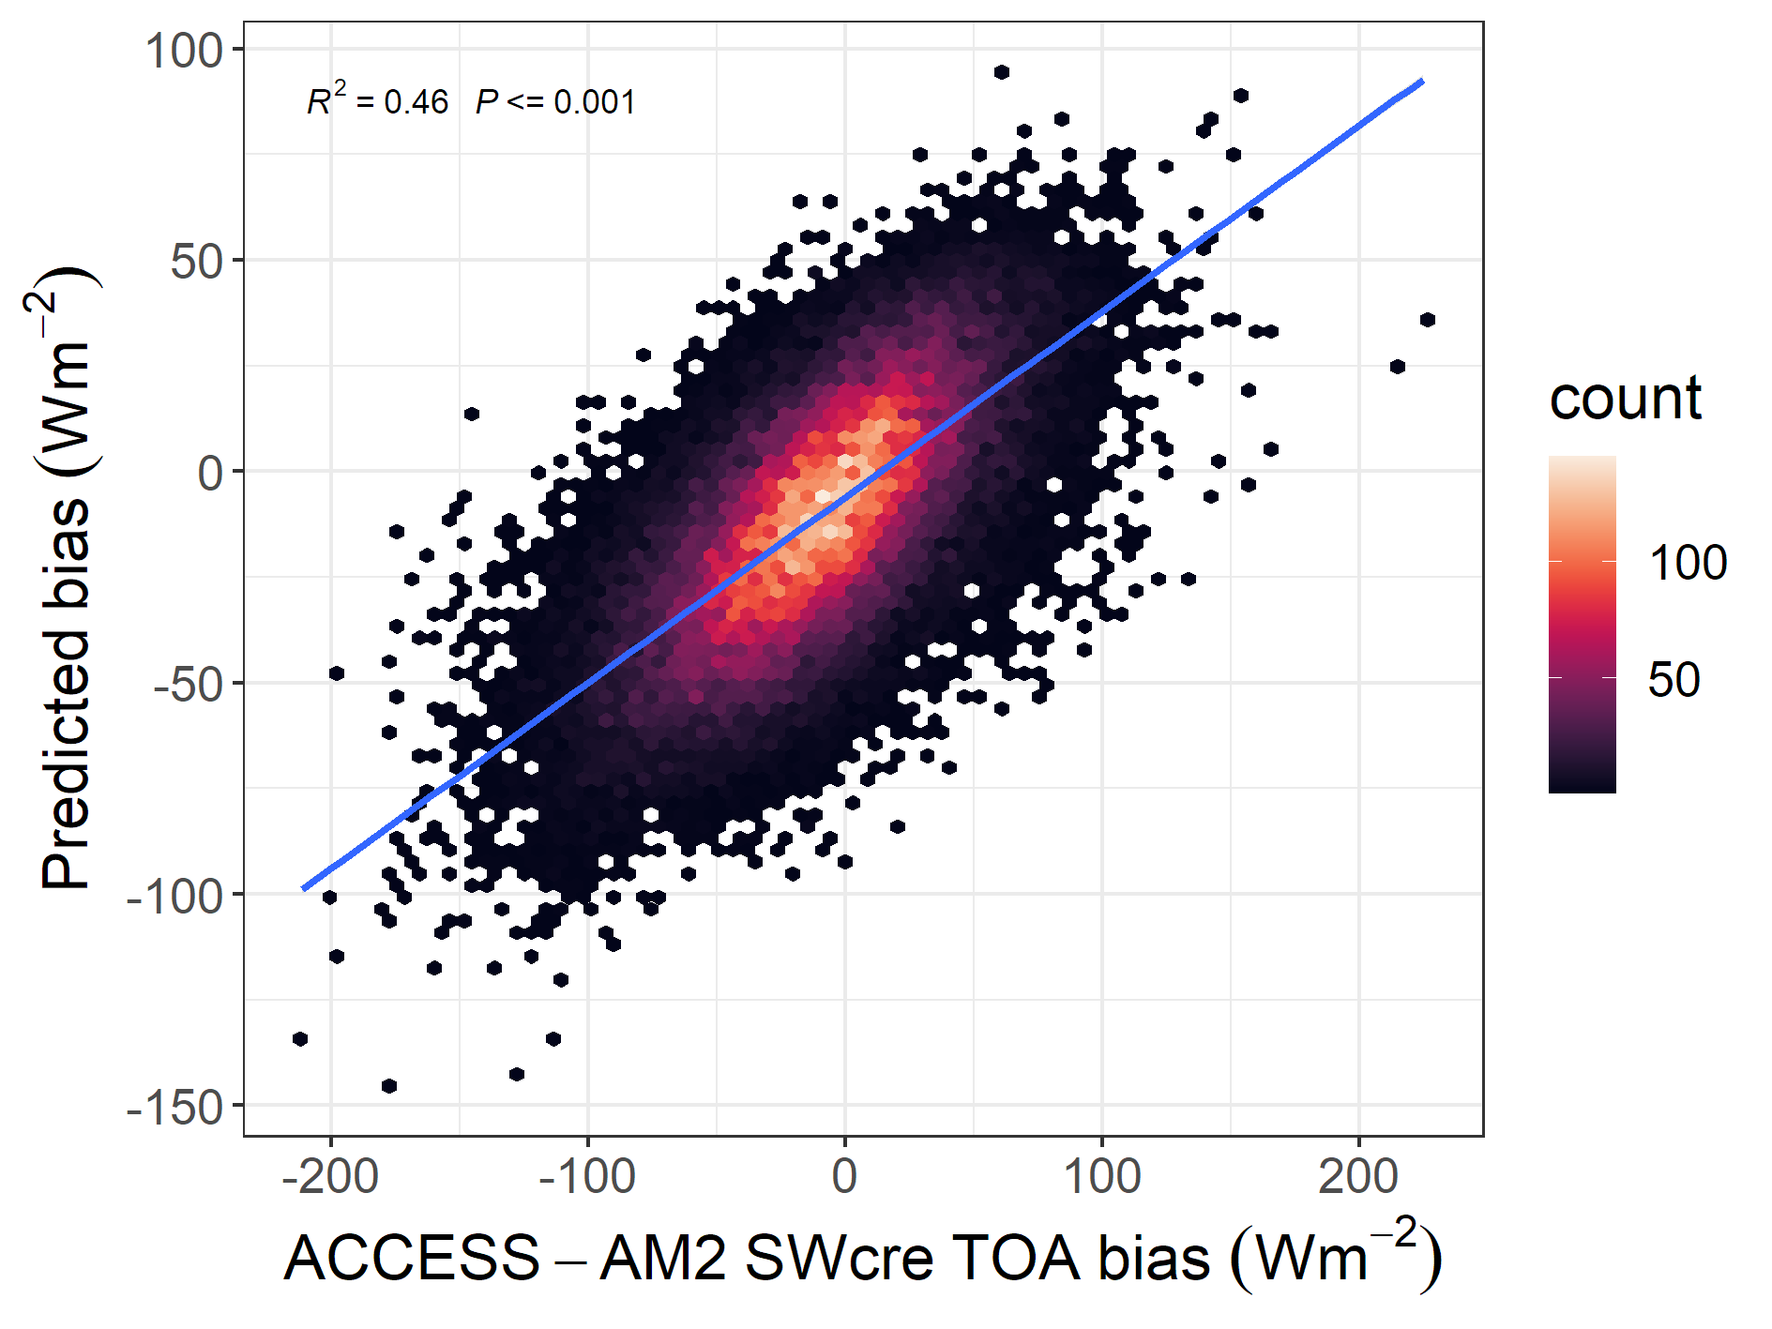
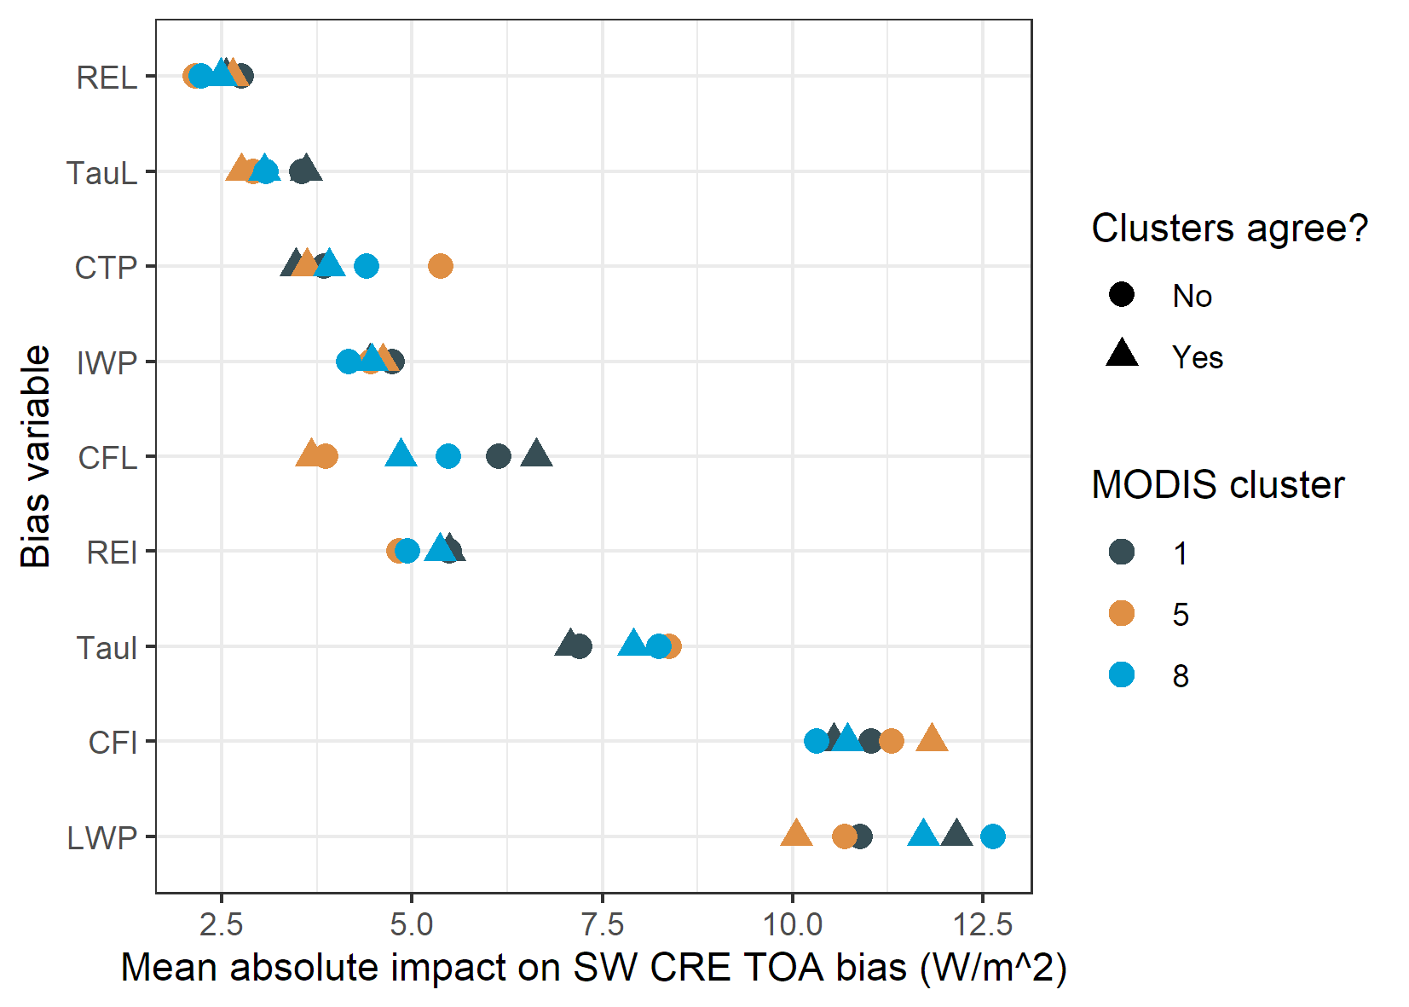
We are taking our evaluation one step further & using machine learning to try to predict the radiative biases and then understand what are the key drivers.
Figures from Marc Mallet

Slide 11
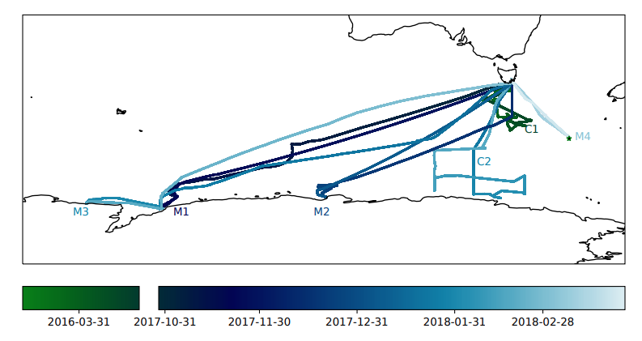
First steps: evaluate!
Using in-situ observations:

Slide 12
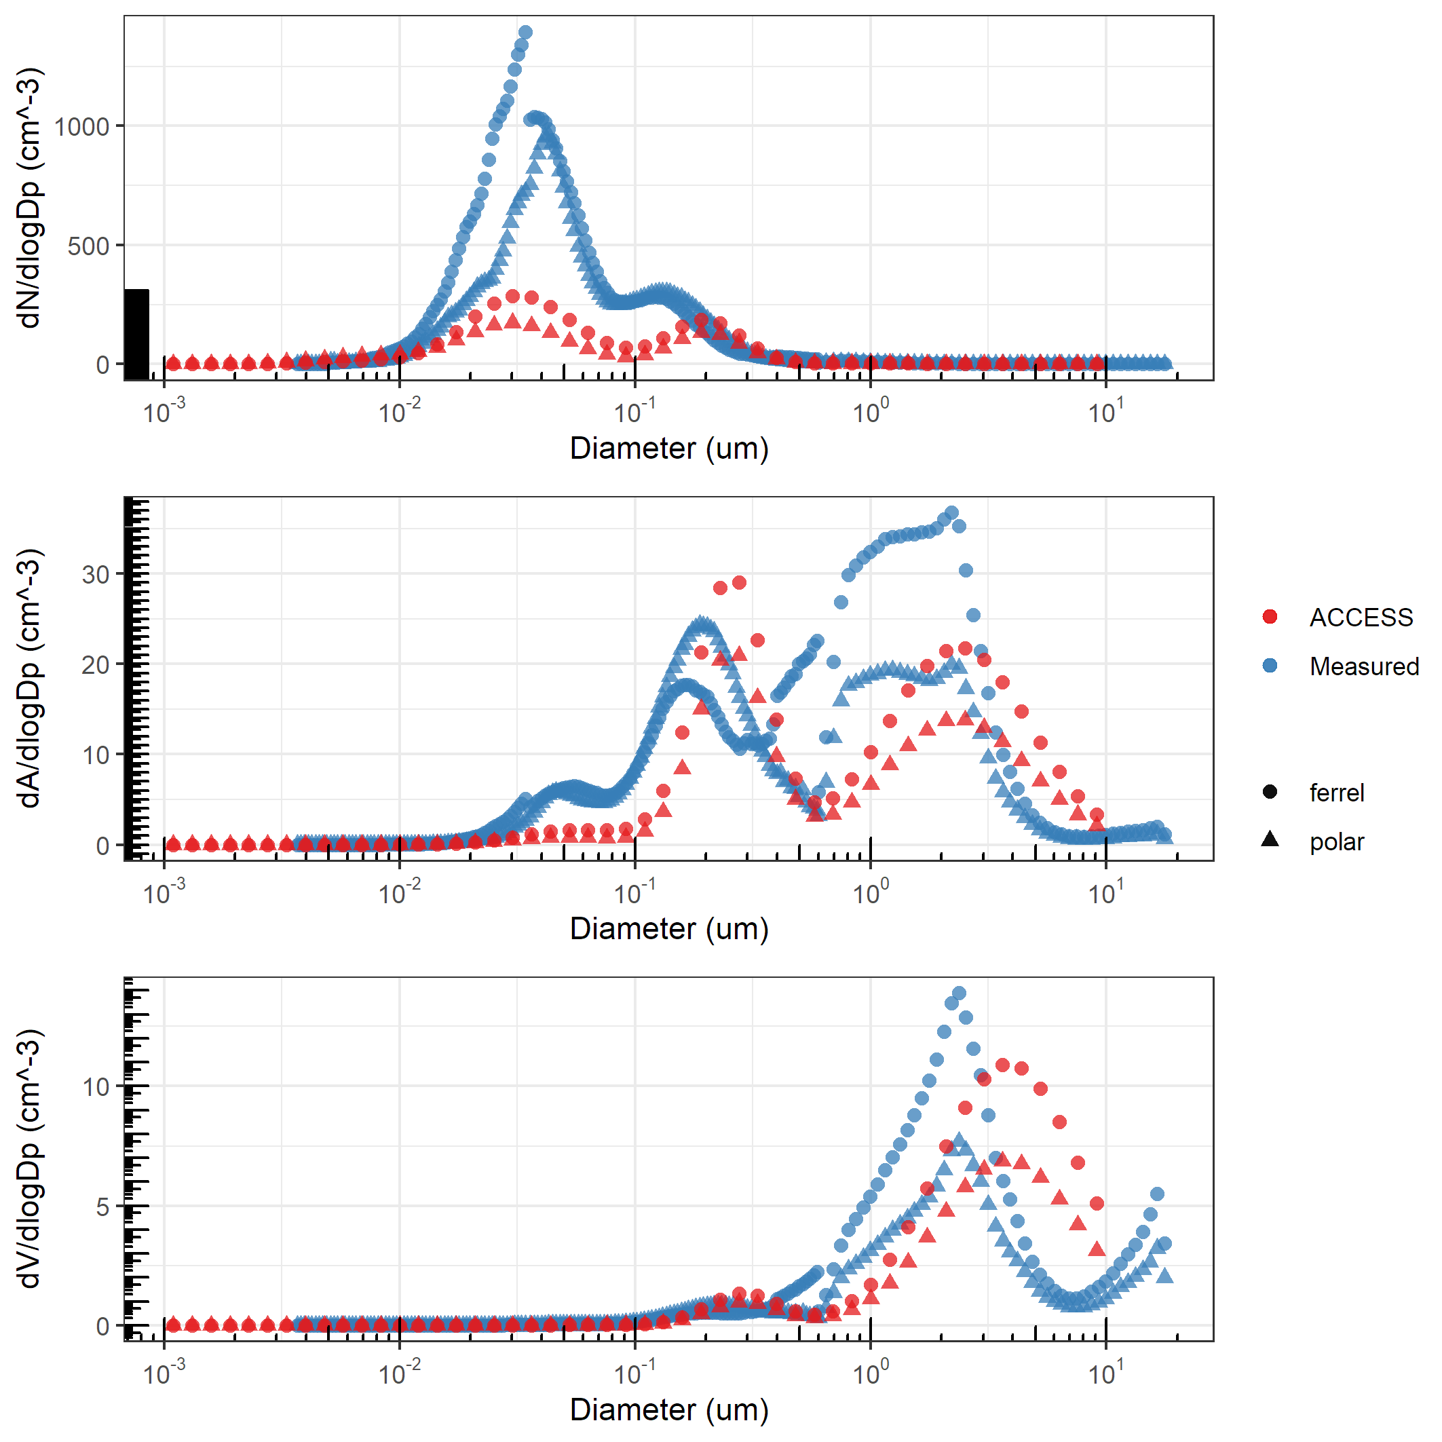
CAPRICORN2 voyage (2018) shows ACCESS captures aerosol size distribution mode centres ok, but underestimates the number concentrations (top plot)
(testing of influence of biogenic aerosol ongoing)
Figure from Marc Mallet

Slide 13
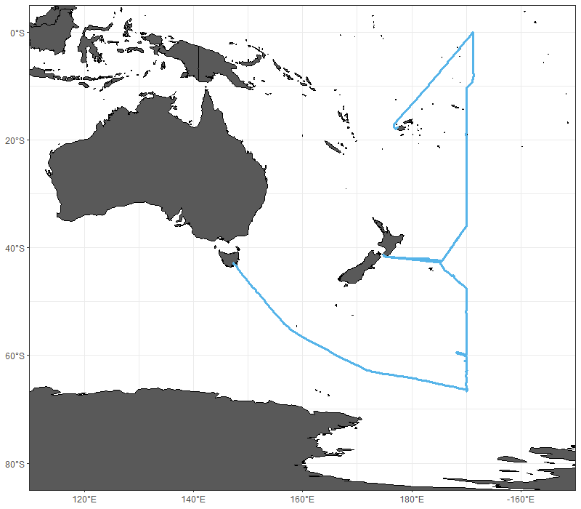
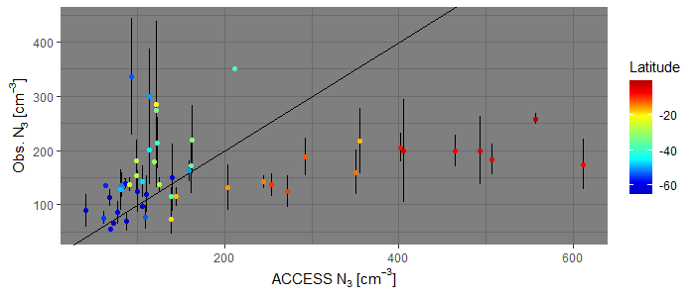
Ice2Equator (2016) voyage shows significant dependence on latitude of ACCESS bias in condensation nuclei (N₃)
(exploration of chemical composition ongoing)
Figures from Joel Alroe

Slide 14
THANK YOU
Any questions?

